Slide 1








Gamerpedia
Enhancing Videogame Discovery for Beginners
START
Oluwadamilola Owolabi
Kosi Okeke

Slide 2






Introduction

Slide 3


Project Overview
Why Gamerpedia?
Over 5M games are available to the public, which is overwhelming to a beginner (nationaltoday.com 2024)
What is Gamerpedia?
A comprehensive database to help users select games based on their preferences.
How it relates to Data Science:
Recommendation Algorithm.
Database Management.
API Integration
Notes:
As many of you may know, the gaming industry today offers an overwhelming variety of titles, each catering to different tastes and interests. For gamers, especially those new to the hobby or those looking to explore new genres, this abundance of options can be both exciting and daunting. Often, the fear of spending money on a game that might not be enjoyable can deter people from trying out new games.
This is where Gamerpedia comes into play. Our platform leverages advanced data science techniques to create a user-friendly and efficient tool that assists gamers in making informed decisions based on their preferences.

Slide 4




Our Process

Slide 5





Key Features
1
2
Recommendation Engine
Game Encyclopedia
Notes:
There were two Key Features we wanted to achieve to our application:
1st is the Recommendation Engine... which is, more specifically, a recommendation system that suggests video games based on preselected parameters and ranks them using ChatGPT.
2nd is the Game Encyclopedia... Which consists of an information hub that provides users with key details about video games, including predicted playtime, news, popularity, release trailers, playthrough videos and top streamers.
Both features are designed to operate independently, ensuring users can either find game recommendations or access detailed information about their specific game options.
NEXT SLIDE IS DAMMY'S. KOSI COMES BACK IN AT THE RECOMMENDATION ENGINE SLIDE

Slide 6




Project Goals
Web Development Using Django
Database Schema Design and Implementation
Recommendation Engine
Game Encyclopedia via API request
Notes:
"In developing Gamerpedia, we focused on four key areas to ensure a robust and user-friendly experience:
- Creating a robust and scalable Web framework Using Django
- Comprehensive Database Schema Design and implementing it into our web framework
- Recommendation Engine that analyzes user preferences and suggests games that best match the users taste
Game Encyclopedia via API request which provides detailed and up-to-date information on user preferred videogames.
By focusing on these four areas, we aim to deliver a comprehensive and enriching experience for gamers, helping them find and learn about games that align with their interests."

Slide 7

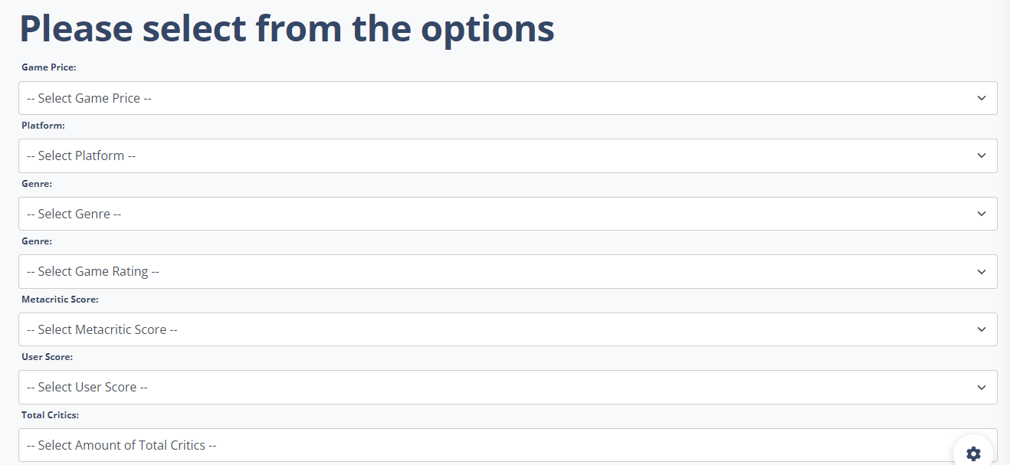





Web Development
Developed a user-friendly interface with optimized navigation and security features
Notes:
This choice was made to provide accessibility of the app to global users. Also, it helps provide the user with a sense of security when putting private information into the app.
The app uses Python Django as its web framework engine. Which is a Python tool that utilizes Python functions and READ/WRITE requests to generate impressive websites. The website can be hosted locally or globally via a web framework.
For the app’s front-end design, the app uses HTML and CSS to create an optimized, visually pleasing, and user-friendly user interface. While in the backend, the app utilizes JavaScript and Python functions to run the app behind the scenes. Django engines are also used for login and sign-in functions.

Slide 8
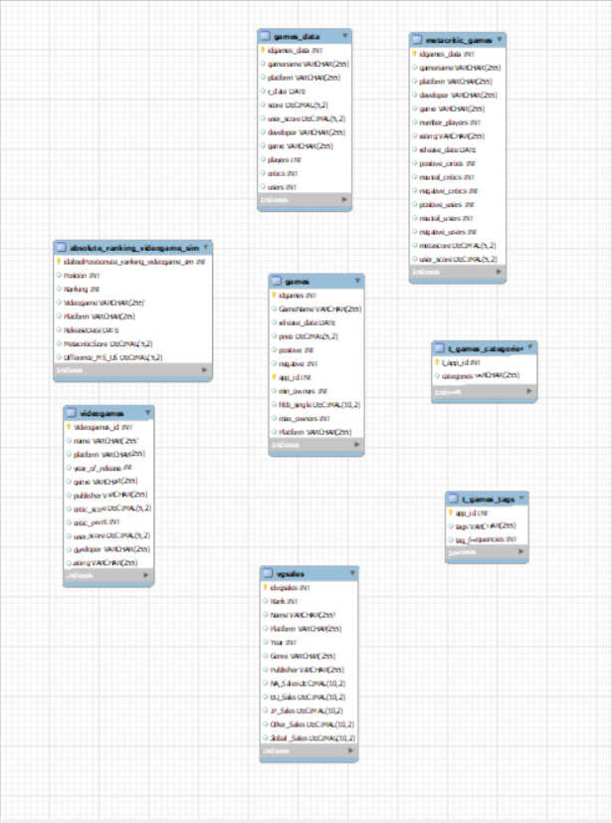

Database Schema Design
Designed a database schema with 11 attributes and over 1.17 million rows.
Notes:
We extracted A total of 9 files were downloaded from Kaggle. Each contains various datasets related to games. Like the games, sales, reviews, tags, scores, etc.
A model of the database tables was created using ‘MySQL Workbench’, where similar tables and attributes were created based on the downloaded files and their columns. After the model was created, an SQL script was generated using forward engineering, where the database was declared, followed by the tables and their attributes, each with its respective datatypes.
The files were uploaded to their respective tables using the ‘LOAD DATA INFILE’ SQL function. After all the files were uploaded to the database. These tables were combined into a new table using the ‘INSERT INTO’ SQL function. The data was optimized by removing duplicate row and filling the null values. The resulting table was downloaded into the app’s local directory.
The result was a Designed a database schema with 11 attributes and over 1.17 million rows.

Slide 9
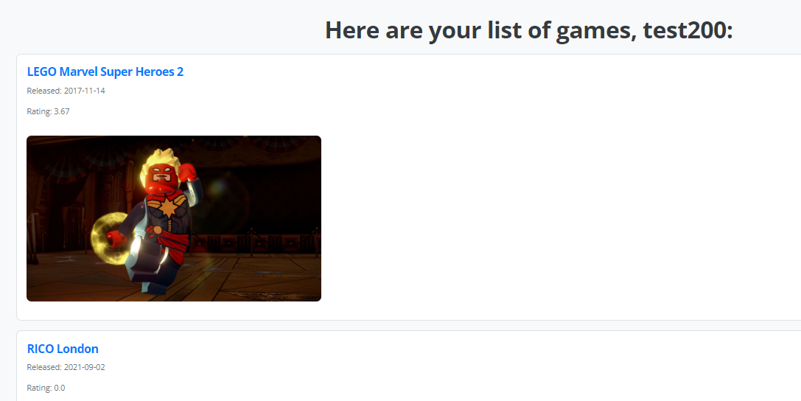

Recommendation Algorithm
Implemented an algorithm based on user scores and Metacritic, with fallback to ChatGPT for ranking.
Notes:
Recommendation Algorithm Implementation: An algorithm function was generated based on the average value from the user score, and Metacritic. This algorithm was utilized whenever the preferences the user selected yielded more than one game suggestion. If the Suggestions do not have an average score or the scores are similar for 2 or more games. ChatGPT AI will be utilized to figure out which game will be the best in terms of ranking for the user based on the preferences.

Slide 10
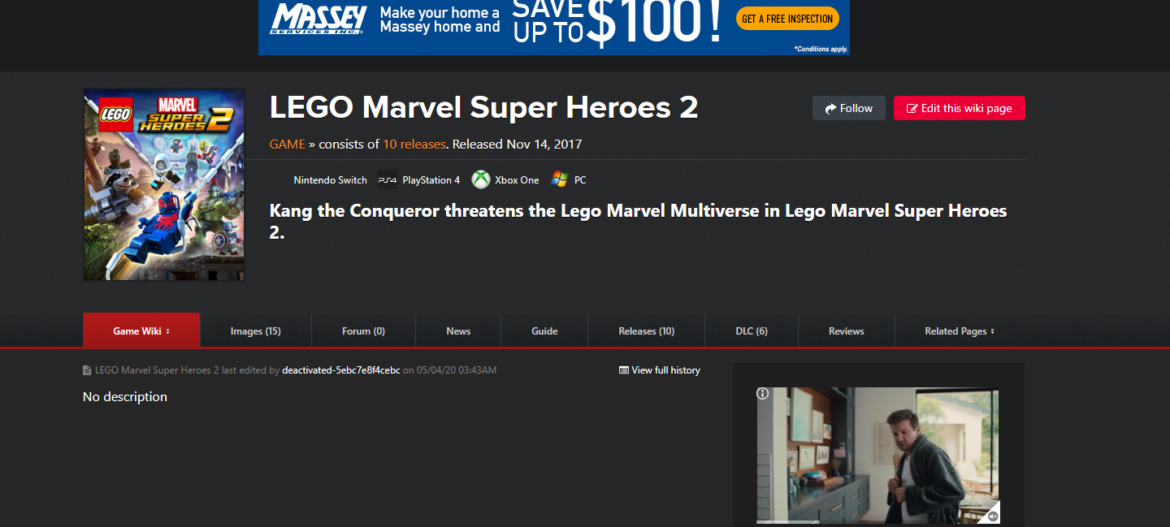

Game Encyclopedia
Integrated APIs to provide detailed information about games, including playtime, news, and top streamers.
Notes:
Generating Game Encyclopedia via API Integration: This last methodology involves creating an information hub that provides users with key details about the user-selected game; including predicted playtime, news, popularity, release trailers, playthrough videos, and top streamers. This involves querying the resources via API integration. The API tools that will be utilized for the apps are IGDB API, which provides relevant information on videogames, their companies, and the employees, and Giant Bomb API which provides reviews, news, and various forms of multimedia content related to the selected game.

Slide 11

Gamerpedia Demo
http://127.0.0.1:8000/
Notes:
Overview: Brief demo of the working software.
Features Highlighted:
- User interface.
- Game recommendation process.
- Information retrieval from the encyclopedia.

Slide 12


Conclusion

Slide 13




“Gamerpedia aims to enhance the gaming experience by helping users find games that match their preferences”
Notes:
The Gamerpedia app aims to resolve the indecisiveness and confusion beginner gamers face when choosing a game that matches their preferences and interests. By integrating a game recommendation feature and an encyclopedia feature, we aim to create a web framework that enhances the overall gamer experience for all users by recommending games based on their preferences and providing detailed resources for each game.
Overall, this will allow Gamerpedia to speed up gaming discovery and selection, enabling gamers to find a game perfectly suited to their unique taste. Using advanced recommendation algorithms and nested information about video games, our platform will assist gamers in finding and selecting games tailored to their individual preferences. At this stage, we look forward to a further enhancement of our tool and releasing it publicly for the gaming community.

Slide 14


Future Work
Replace Missing values with the correct data
Create a more optimized game encyclopedia geared for the Web App
Work on creating graphs and charts for the user based on his preference
Push the website to the cloud
Enable a web scraping feature/API integration to extract Real Time game data
Notes:
"As we move forward with the Gamerpedia project, we have identified several key areas for future development and improvement to enhance the overall user experience.
First, we aim to replace missing values in our database with the correct data. Accurate and complete data is crucial for providing reliable recommendations and detailed game information. By filling these gaps, we can ensure our database remains robust and trustworthy.
Second, we plan to work on creating dynamic graphs and charts for users based on their preferences. These visualizations will provide insightful and personalized data, helping users make more informed decisions about the games they choose.
Third, we are committed to optimizing our game encyclopedia to be more geared towards our web app. This involves refining the layout, improving the speed, and ensuring that the information presented is both comprehensive and easily accessible. Our goal is to create an encyclopedia that users find both informative and enjoyable to use.
Fourth, we intend to push our website to the cloud. By hosting Gamerpedia on a cloud platform, we can ensure greater accessibility, scalability, and reliability. This move will allow us to handle increased traffic and provide a seamless experience to users worldwide.
Finally, we plan to enable a web scraping feature or integrate APIs to extract real-time game data. This will ensure that our database is always up-to-date with the latest information, trends, and developments in the gaming world. Real-time data will enhance the accuracy of our recommendations and the relevance of the information in our encyclopedia.

Slide 15

References
Quantic Foundry. (2018, January 15). Video game recommendation engine. Quantic Foundry. https://apps.quanticfoundry.com/recommendations/gamerprofile/videogame/
Recommending games like your favourites. Games Finder. (2013, April 14). https://gameslikefinder.com/
YouTube. (2005, April 28). YouTube. https://www.youtube.com/
Twitch. (2002, July 5). https://www.twitch.tv/
Video game news, reviews, and walkthroughs. IGN. (1998, December 3). https://www.ign.com/
Owning a video game is much harder than it should be in 2022. (2022, August 11). Digital Trends. https://www.digitaltrends.com/gaming/game-ownership-digital-media-players-weigh
Notes:
"As we move forward with the Gamerpedia project, we have identified several key areas for future development and improvement to enhance the overall user experience.
First, we aim to replace missing values in our database with the correct data. Accurate and complete data is crucial for providing reliable recommendations and detailed game information. By filling these gaps, we can ensure our database remains robust and trustworthy.
Second, we plan to work on creating dynamic graphs and charts for users based on their preferences. These visualizations will provide insightful and personalized data, helping users make more informed decisions about the games they choose.
Third, we are committed to optimizing our game encyclopedia to be more geared towards our web app. This involves refining the layout, improving the speed, and ensuring that the information presented is both comprehensive and easily accessible. Our goal is to create an encyclopedia that users find both informative and enjoyable to use.
Fourth, we intend to push our website to the cloud. By hosting Gamerpedia on a cloud platform, we can ensure greater accessibility, scalability, and reliability. This move will allow us to handle increased traffic and provide a seamless experience to users worldwide.
Finally, we plan to enable a web scraping feature or integrate APIs to extract real-time game data. This will ensure that our database is always up-to-date with the latest information, trends, and developments in the gaming world. Real-time data will enhance the accuracy of our recommendations and the relevance of the information in our encyclopedia.

Slide 16



Questions or Feedback!
Notes:
Thank you for your time and attention. We hope our presentation has provided you with a comprehensive understanding of the Gamerpedia project and its potential impact on the gaming community. We are excited about the future developments and enhancements of Gamerpedia and look forward to your feedback and questions.

